Slide 1
Class of 2018 senior information
Wednesday, March 21
RPHS Auditorium
Class of 2018 sponsor Susanna Jakubik

Slide 2
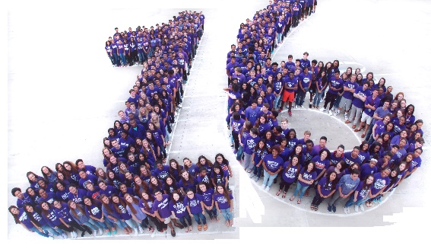
Class photo
Entire class featured in panoramic photo and “18” photo
Wednesday, April 18, 2018, 11:00 a.m.
All seniors to wear purple
Taken by Herndon Panoramics
Packages from $25 to $45
*included in Senior Package

Slide 3
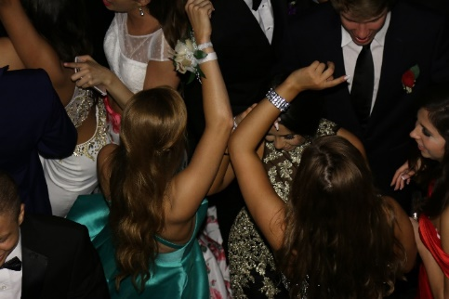
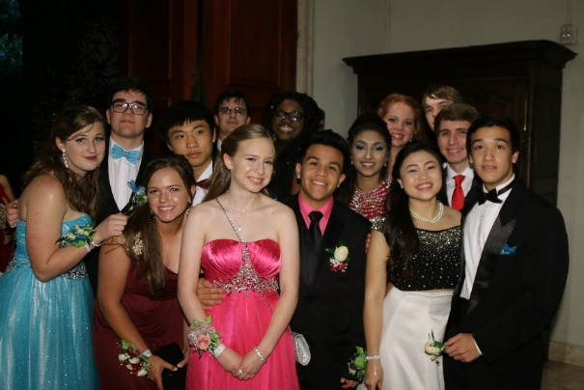
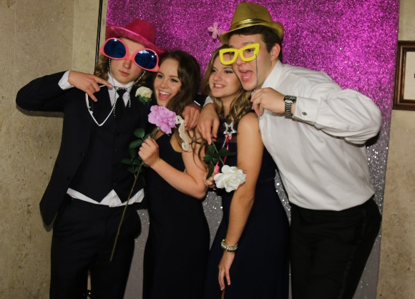
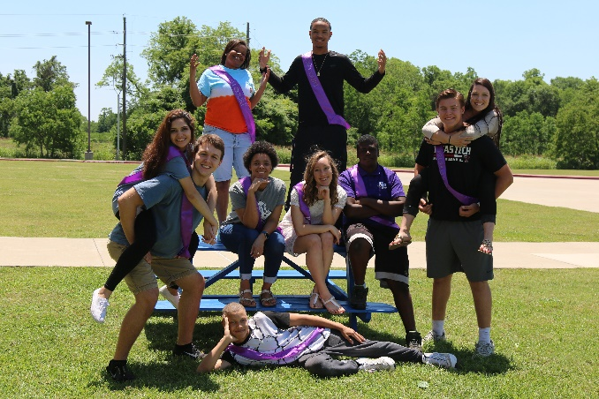
Prom – “Corinthian courtyard”
Saturday, May 12, 2018, 8-12
The Bell Tower on 34th Street
Tickets go on sale Monday, April 9
A la carte price $115
*included in Senior Package

Slide 4
Prom – “Corinthian courtyard”
Video produced by Bailey Landry, Amaya Coleman and Kathleen Cruz

Slide 5
Prom dress code - girls
Formal dress
Length: dress hem or slit may not be shorter than mid-thigh when arms are raised
Neckline: front of dress should not dip lower than cleavage
Cleavage should not be visible. A mesh panel may be sewn into cleavage to make dress appropriate
Back: Open-backed dresses may not dip lower than natural waist
Midriff: A maximum exposure of TWO INCHES will be allowed
Belly buttons should not be exposed

Slide 6
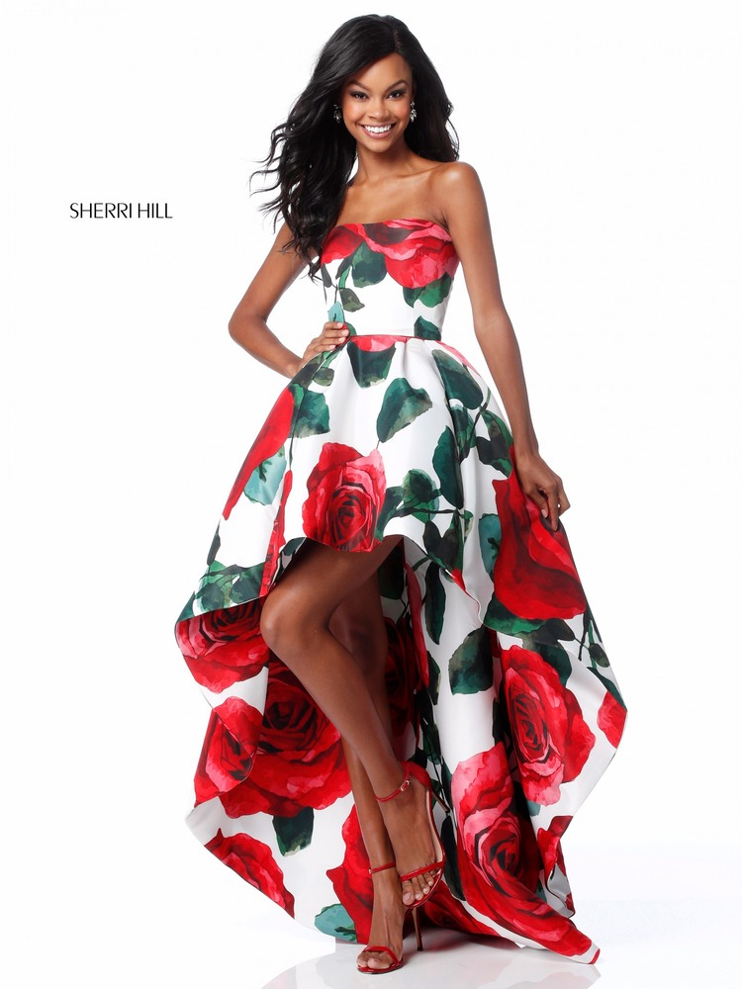
acceptable girls’ dress

Slide 7
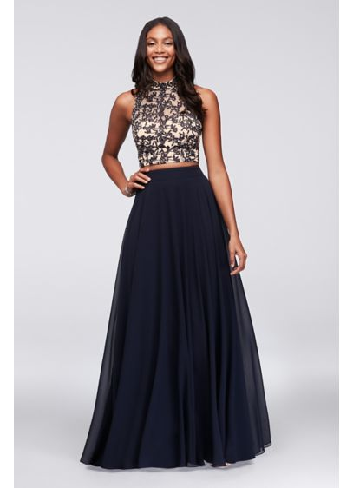
acceptable girls’ dress

Slide 8
Unacceptable girls’ dress
Cutout is more than two inches
Navel is visible

Slide 9
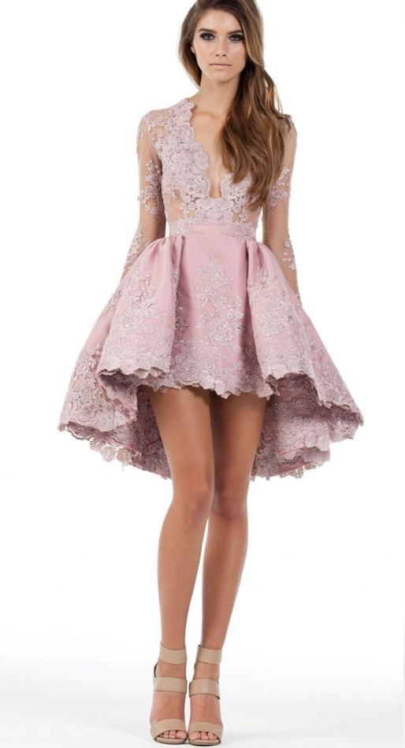
Unacceptable girls’ dress
Cleavage visible
Slit too high
Cleavage visible
Skirt too short

Slide 10
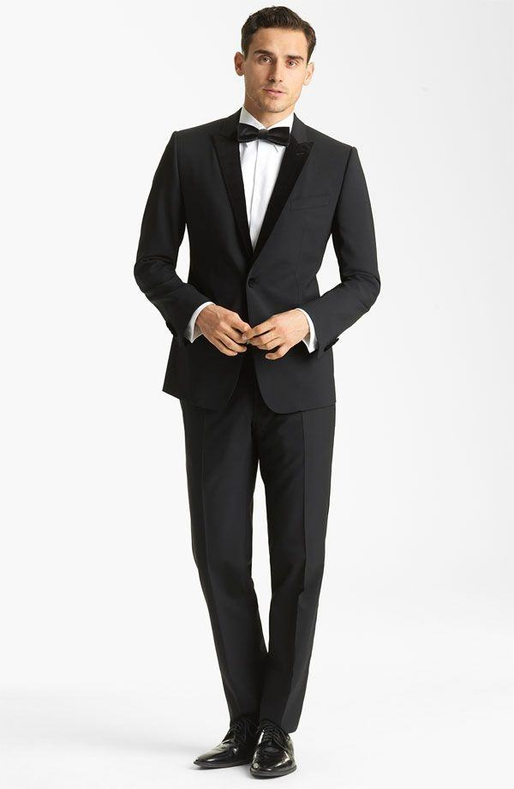
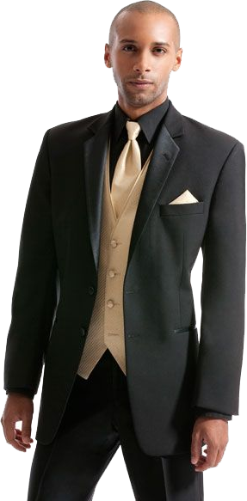
Guys’ dress code
Formal dress
Tuxedos preferred
Dark suits acceptable
Pants must be worn at the waist
No sagging
No undergarments showing

Slide 11
Prom fashion show Saturday, march 24 7pm
Video produced by Sam Clegg

Slide 12
Senior scram
Friday, May 18, 2018
Fiesta Texas (San Antonio)
Coach bus transportation
Cost includes park ticket, transportation and lunch
Tickets go on sale April 9
$95 a la carte
*included in Senior Package
Must wear Senior T-shirt

Slide 13
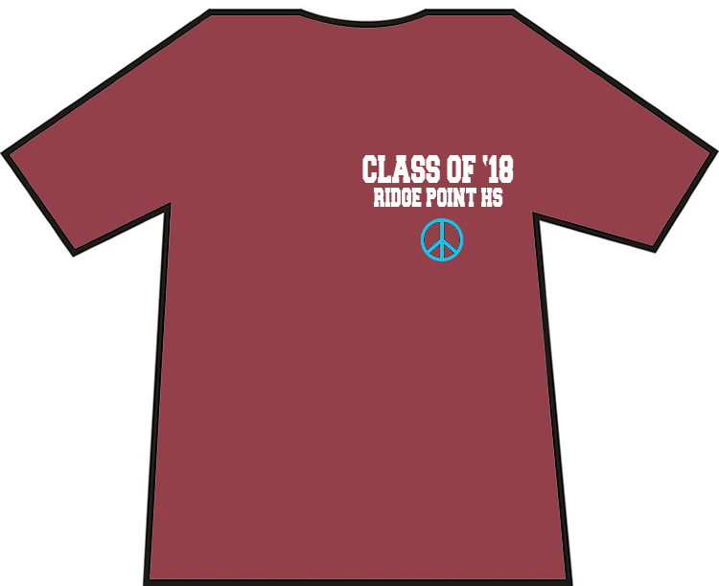
Class t-shirt
On sale in J106
$20, cash or check only
Required attire for Senior Scram
Fun to wear all year long!
*included in Senior Package

Slide 14
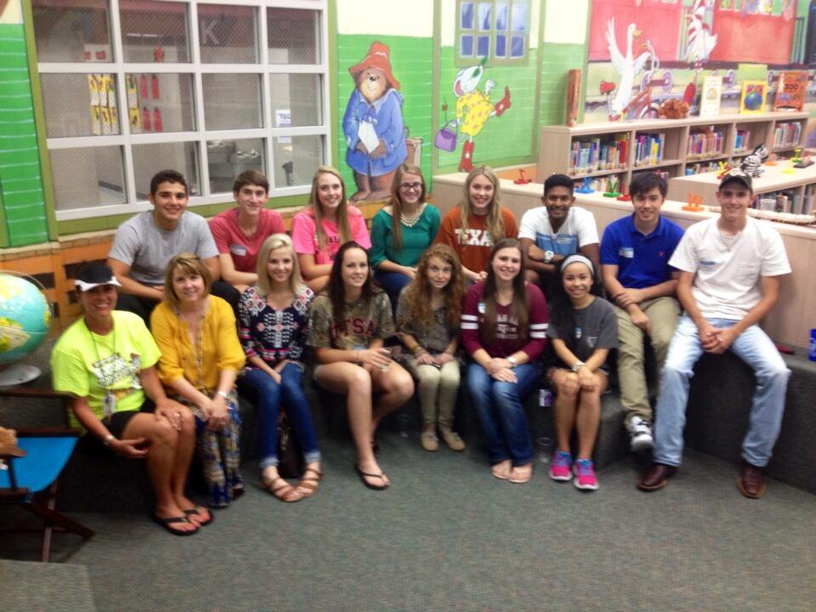
Elementary receptions
Feeder elementary schools host receptions for former students who are graduating
Scanlan Oaks (May 23, 3:45)
Sienna Crossing TBD
Schiff TBD

Slide 15
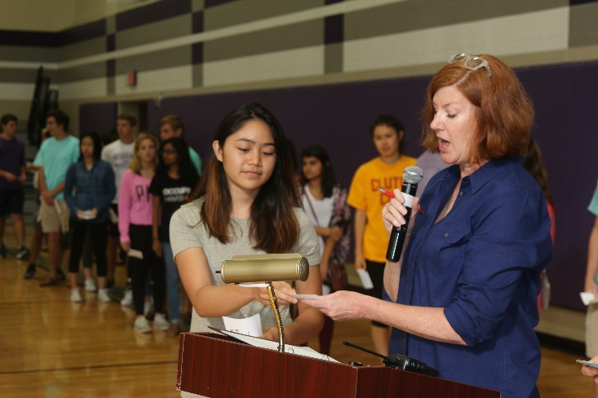
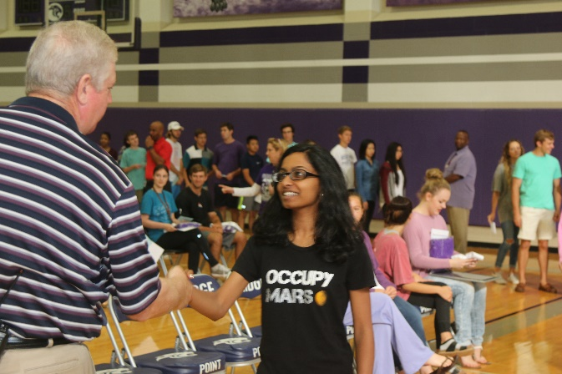
Graduation rehearsal
Mandatory for all seniors
In RPHS large gym during class day
Caps and gowns and graduation tickets will be distributed
Will be held Wednesday, May 30 8am -10am

Slide 16
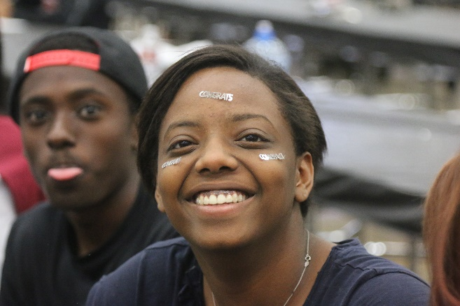
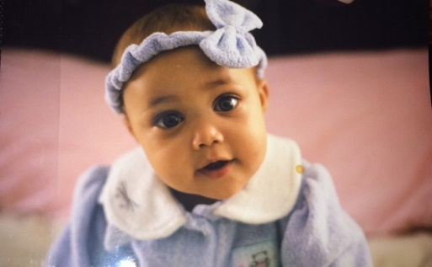
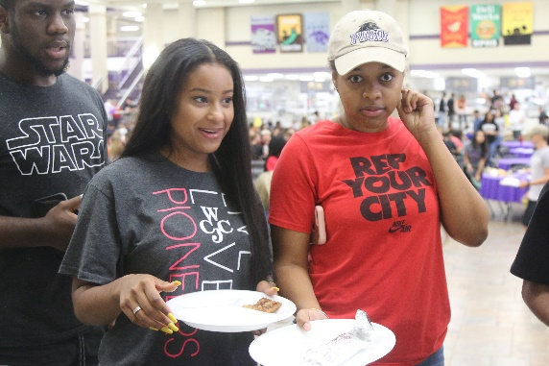
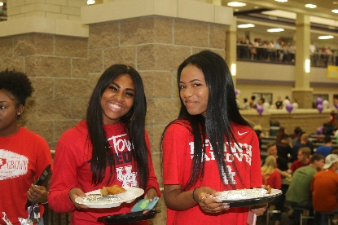
Senior breakfast
Breakfast honoring seniors in RPHS Commons
Senior video is shown
Photos due by May 4 on theProwler!
Thursday, May 31
Tickets go on sale in May
A la carte price TBD
*included in Senior Package

Slide 17
Class of 2018 Scholarship
RPHS will be awarding a $1,000 scholarship to TWO seniors.
Must be planning to attend a 2-year college, 4-year college or tech school
To be eligible, candidates must:
Complete application
Include copy of your acceptance letter
Essay

Slide 18
Class of 2018 Scholarship
Essay
Less than 500 words
Select ONE prompt for your essay:
How has RPHS shaped you as a person? What advice do you have to incoming freshmen on what it takes to be a panther?
Every Monday you hear the song "World Changers." How are you planning to be a world changer?

Slide 19
Class of 2018 Scholarship
Application
Log in to Naviance
Click on Scholarship List/RPHS Class of 2018 Scholarship
Due by midnight on May 4, 2018
Winners will be announced at the Senior Breakfast

Slide 20
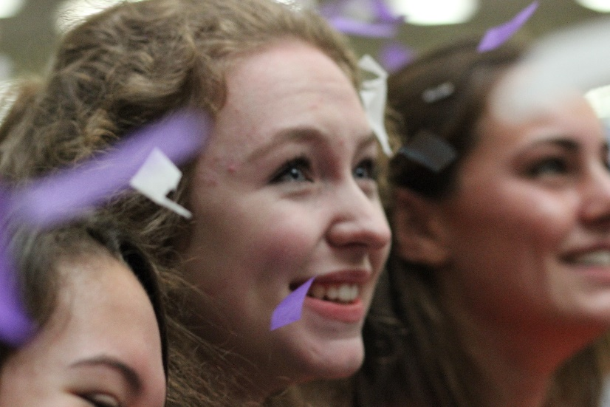
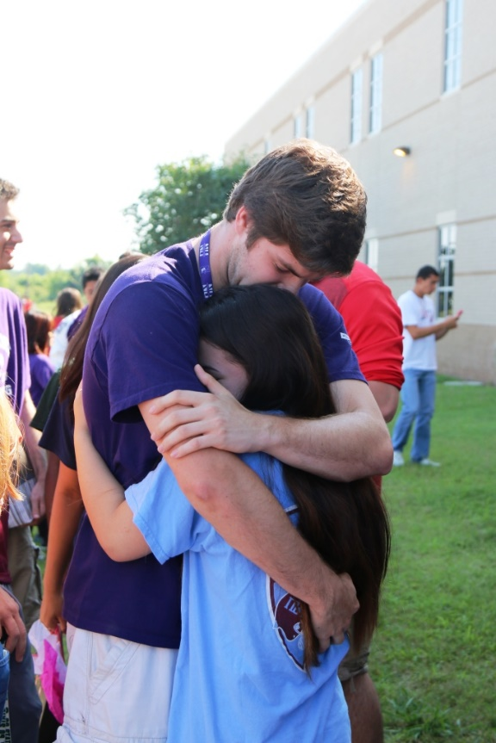
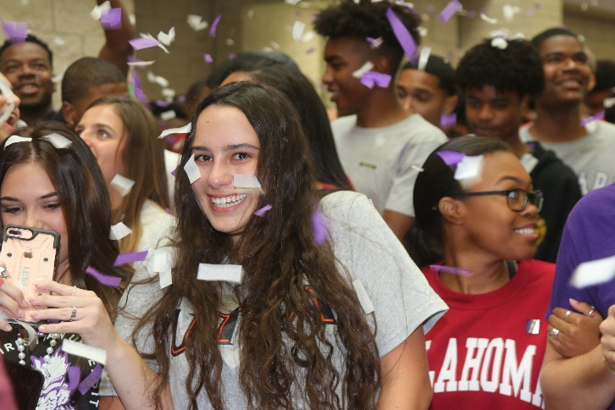
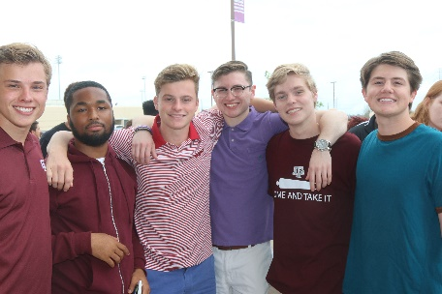
Last walk
One final walk down Main Street, lined with the entire school, parents and families
School song echoes in the hallways and confetti cannons shower grads with purple, silver and white
Immediately following Senior Breakfast

Slide 21
graduation
Saturday, June 2 8:30 a.m., Smart Financial Centre
Seniors will ride buses from campus to venue
Seniors will be allowed to ride home with family
Everyone will automatically receive eight tickets
Everyone who requested up to seven additional tickets will receive them
Tickets will be distributed at grad rehearsal along with cap and gown

Slide 22
Thank you!
Class of 2018

